Slide 1


Slide 2
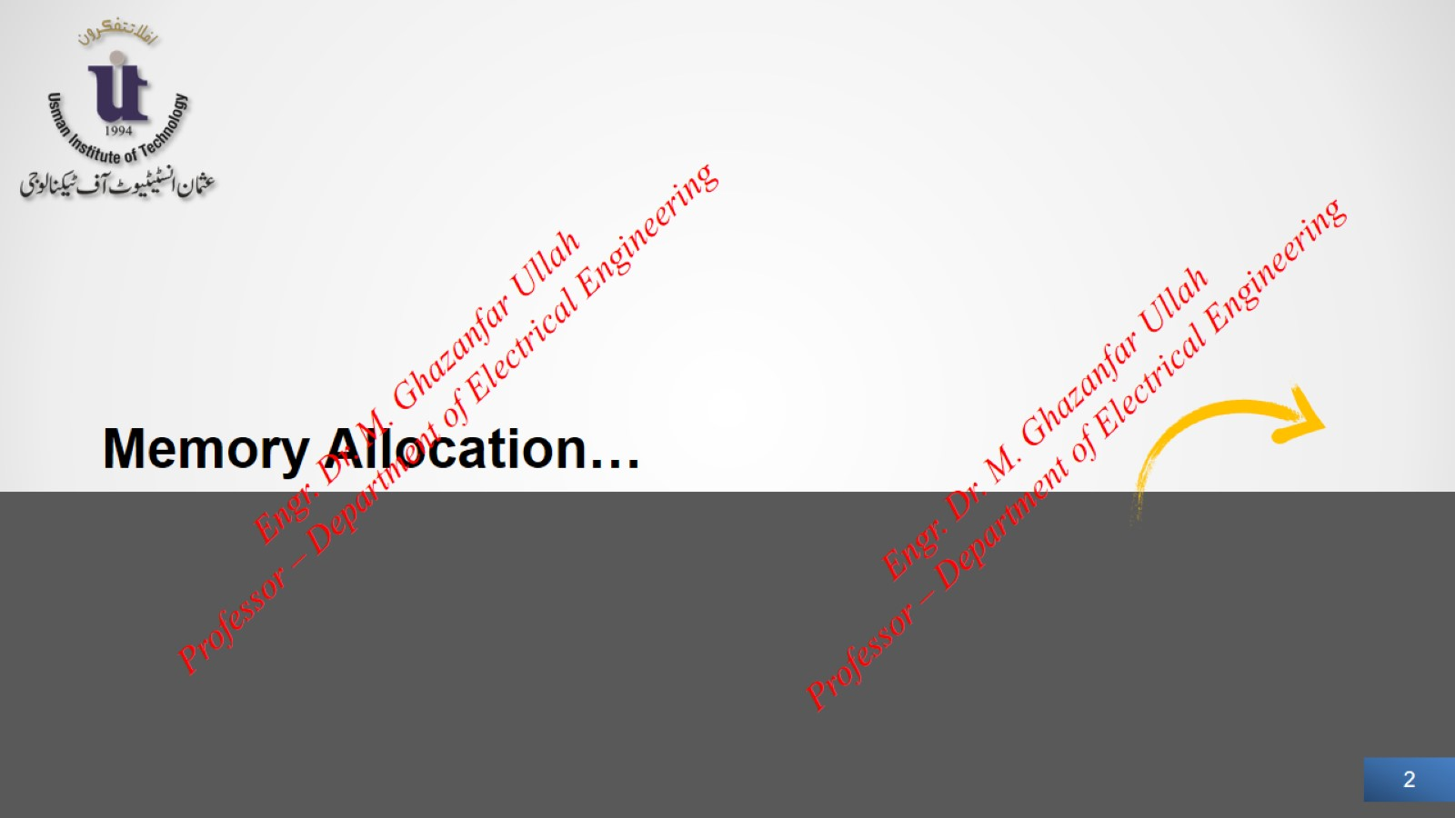

Slide 3
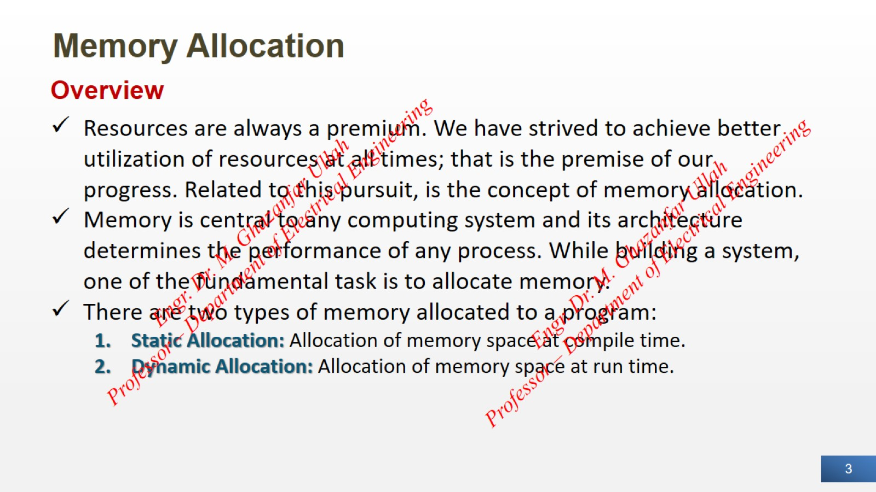
Memory Allocation

Slide 4
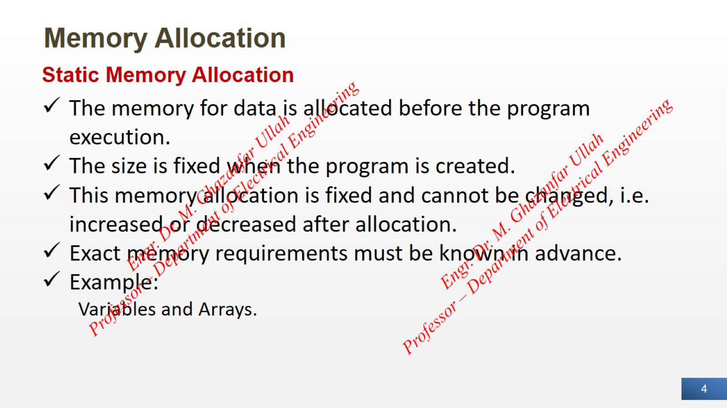
Memory Allocation

Slide 5
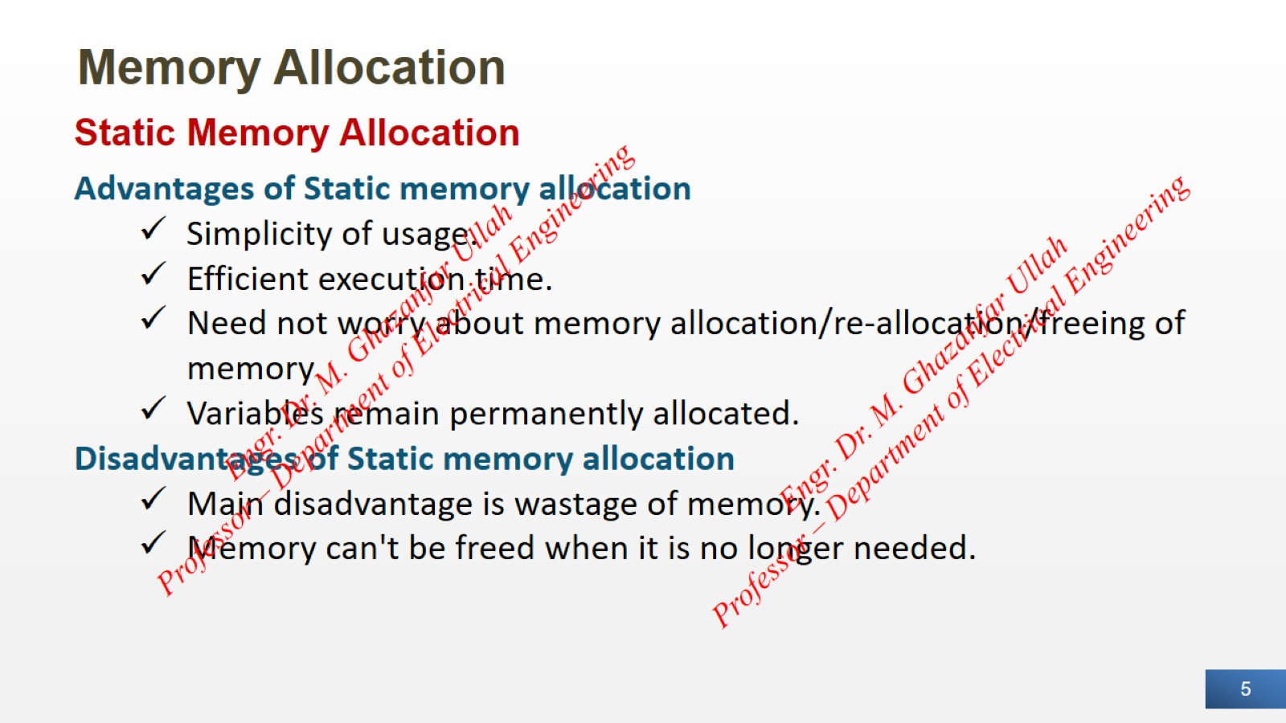
Memory Allocation

Slide 6
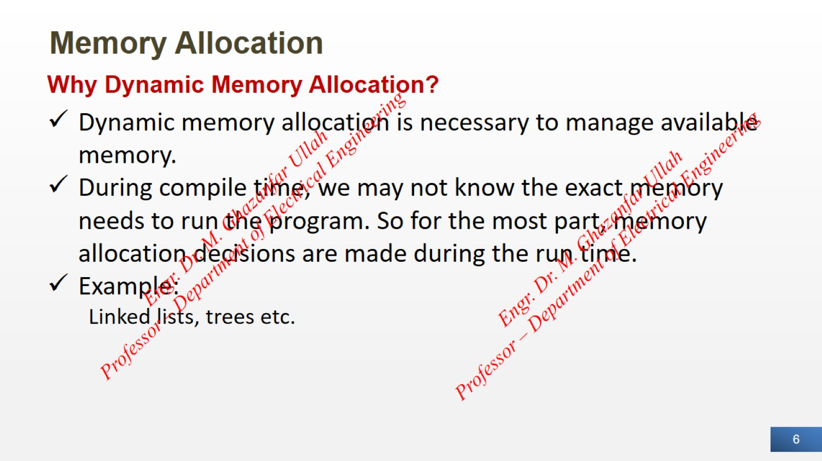
Memory Allocation

Slide 7
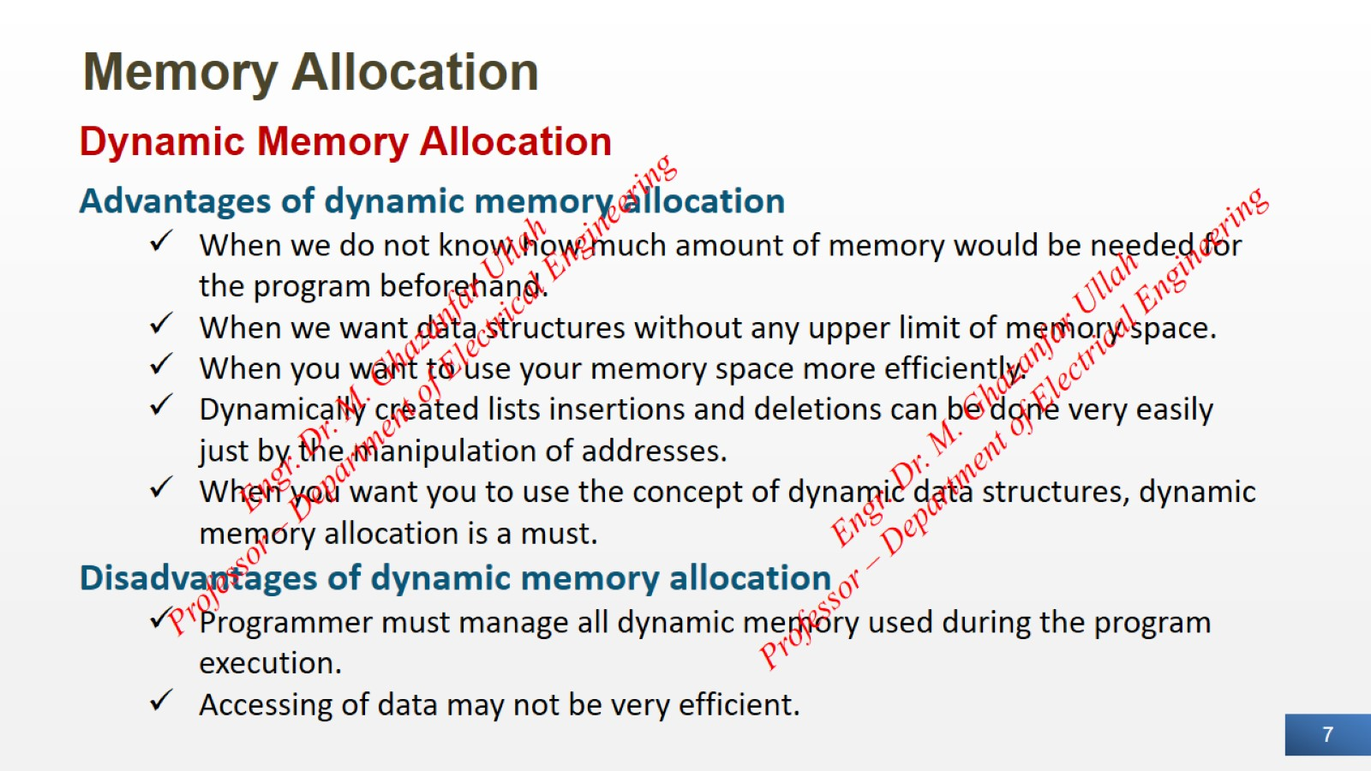
Memory Allocation

Slide 8
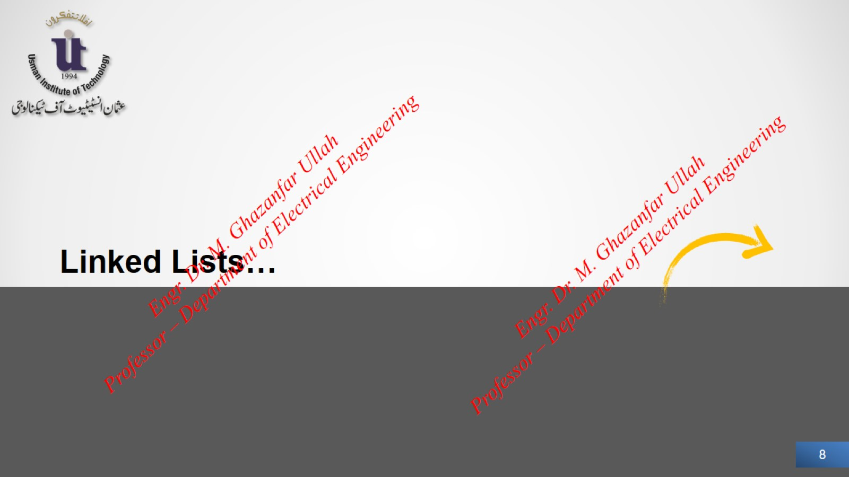

Slide 9
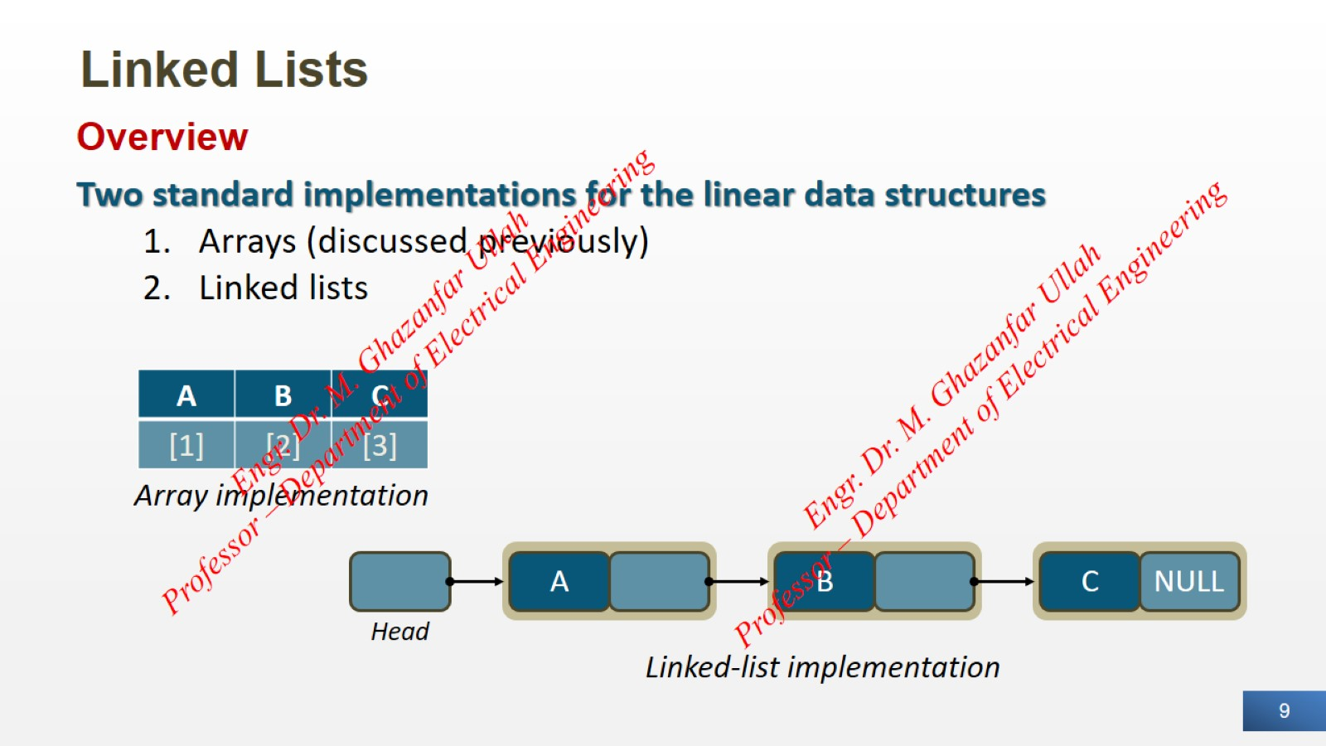
Linked Lists

Slide 10
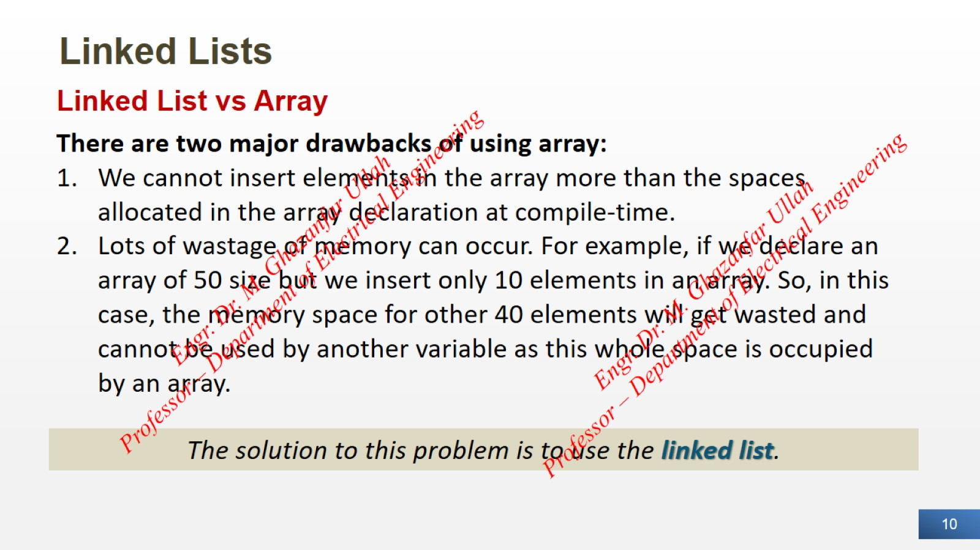
Linked Lists

Slide 11
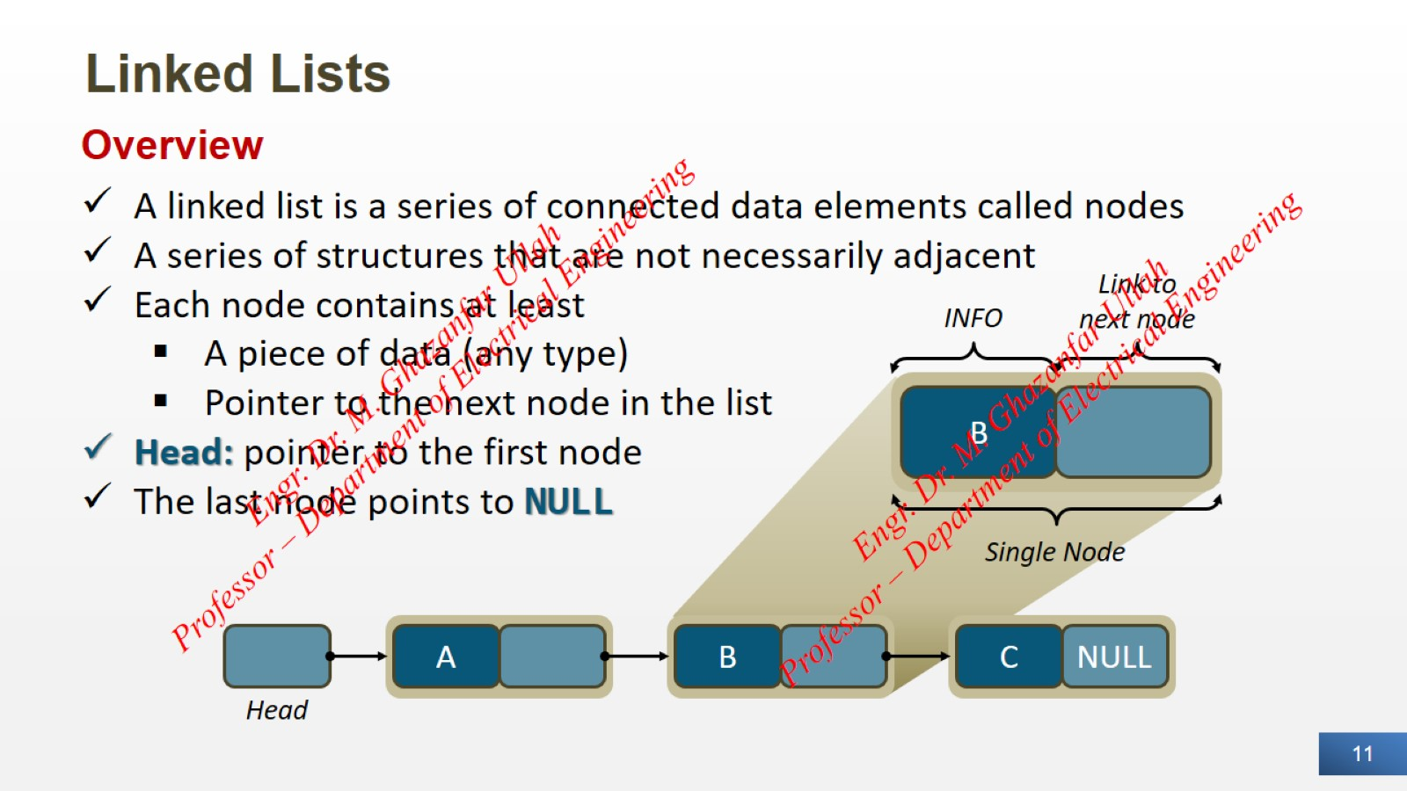
Linked Lists

Slide 12
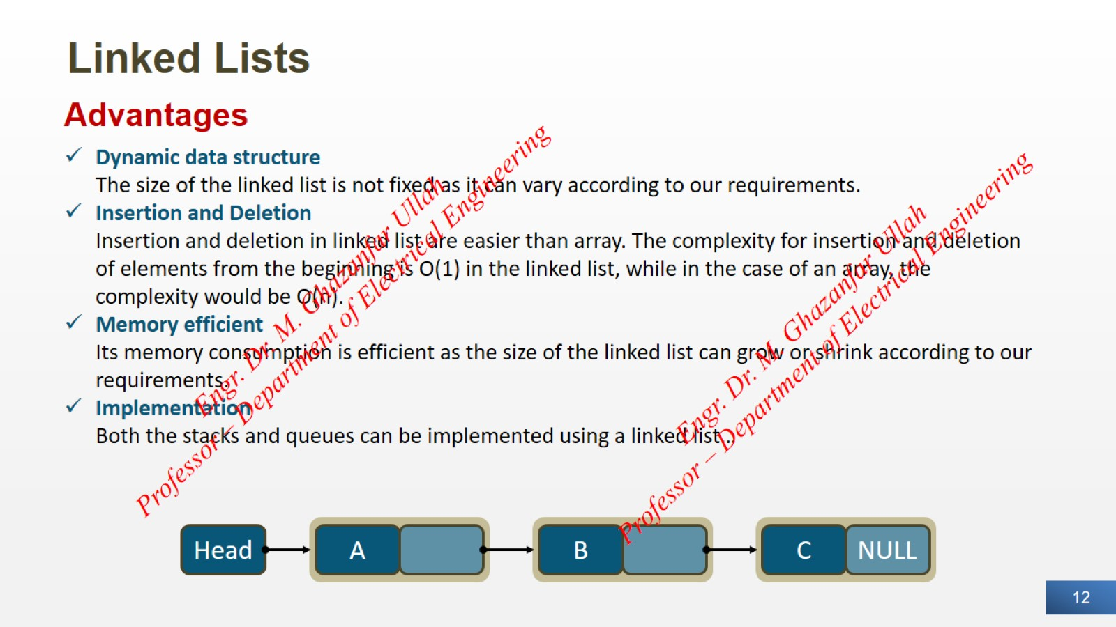
Linked Lists

Slide 13
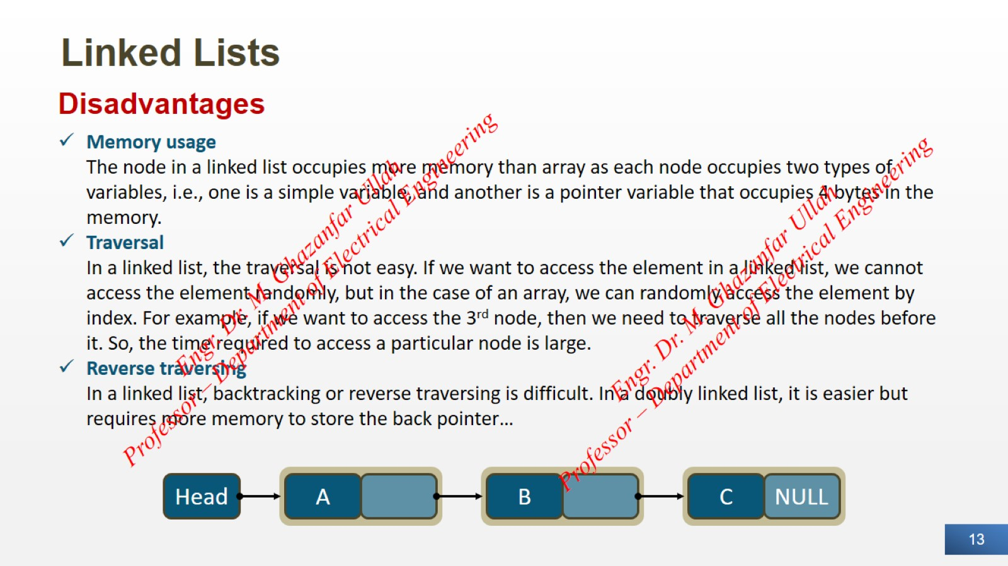
Linked Lists

Slide 14
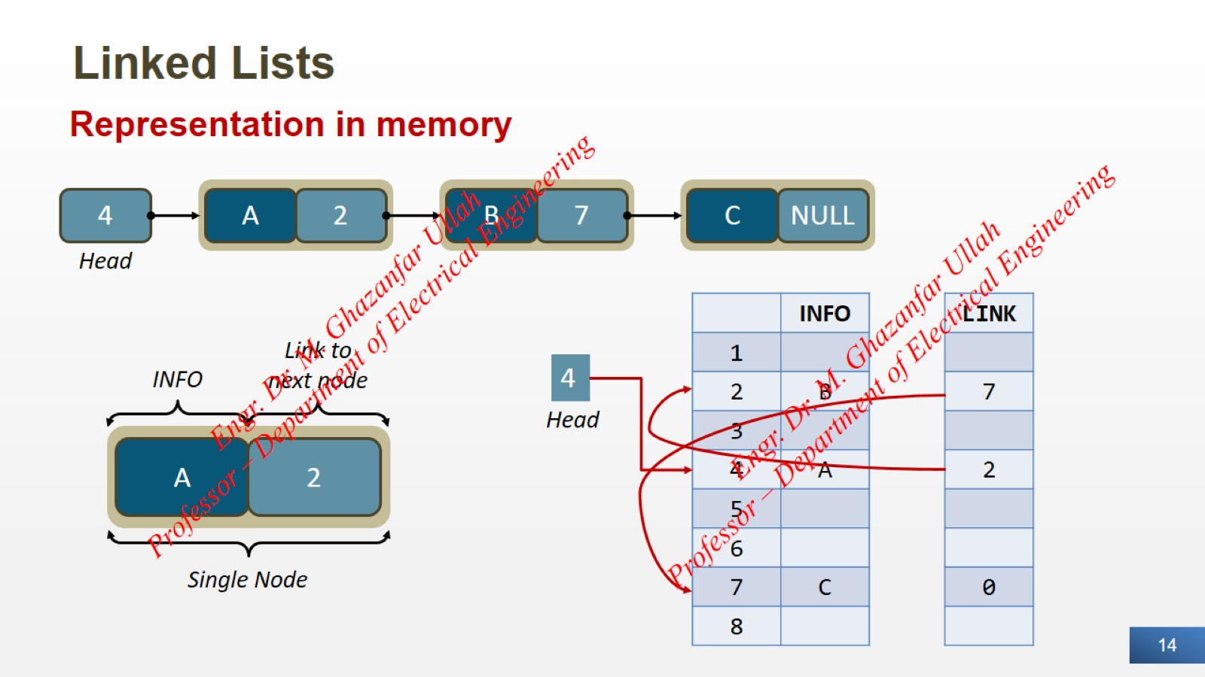
Linked Lists

Slide 15
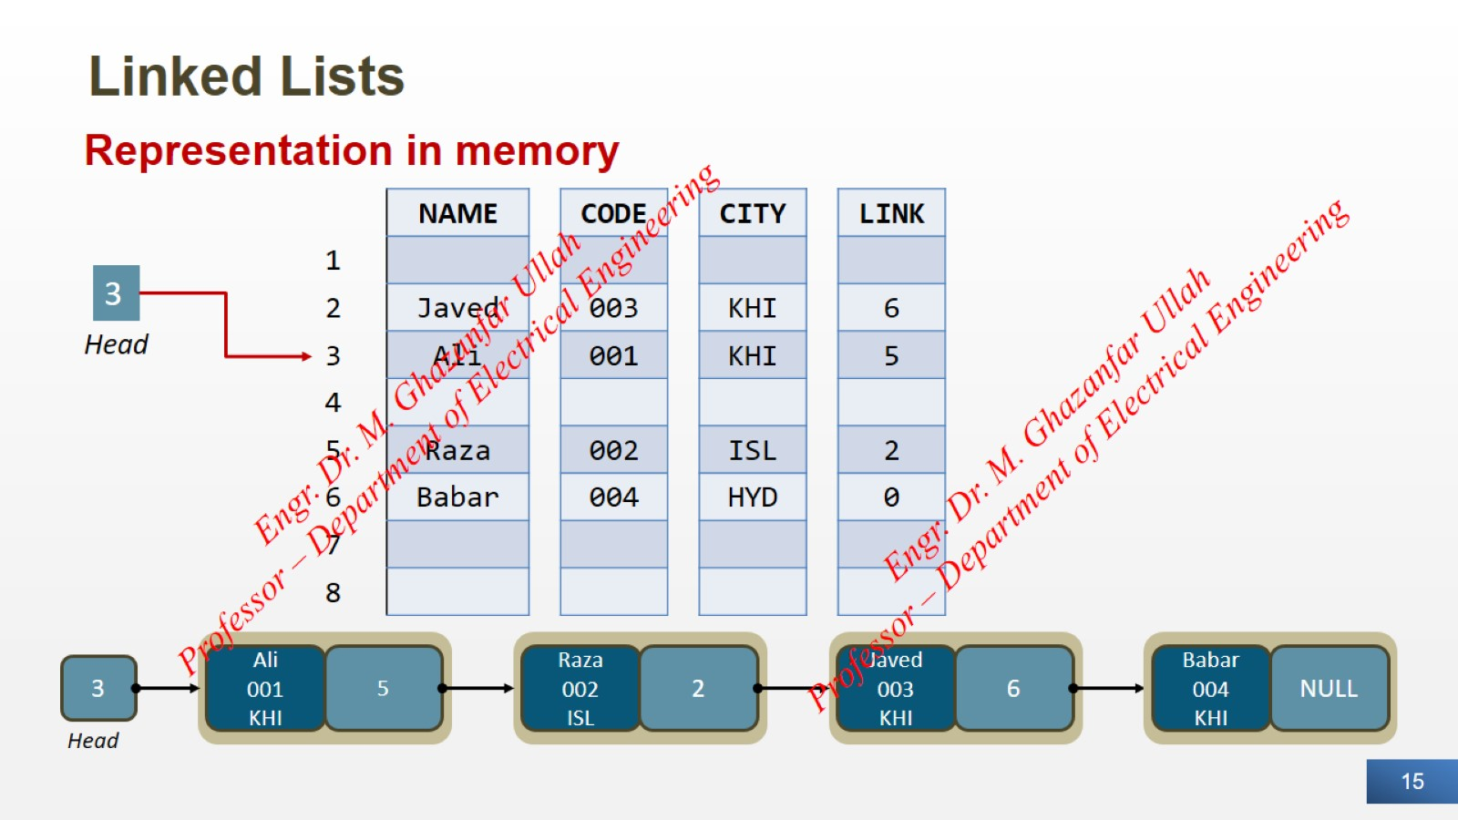
Linked Lists

Slide 16
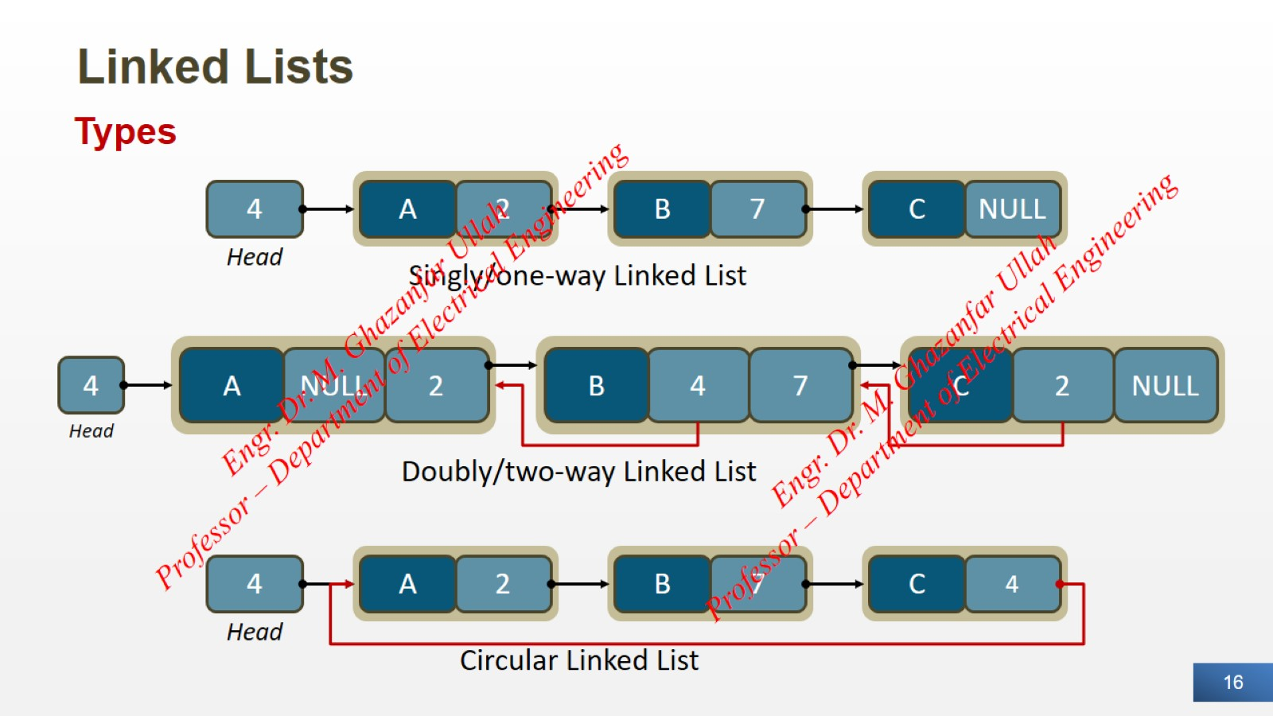
Linked Lists

Slide 17
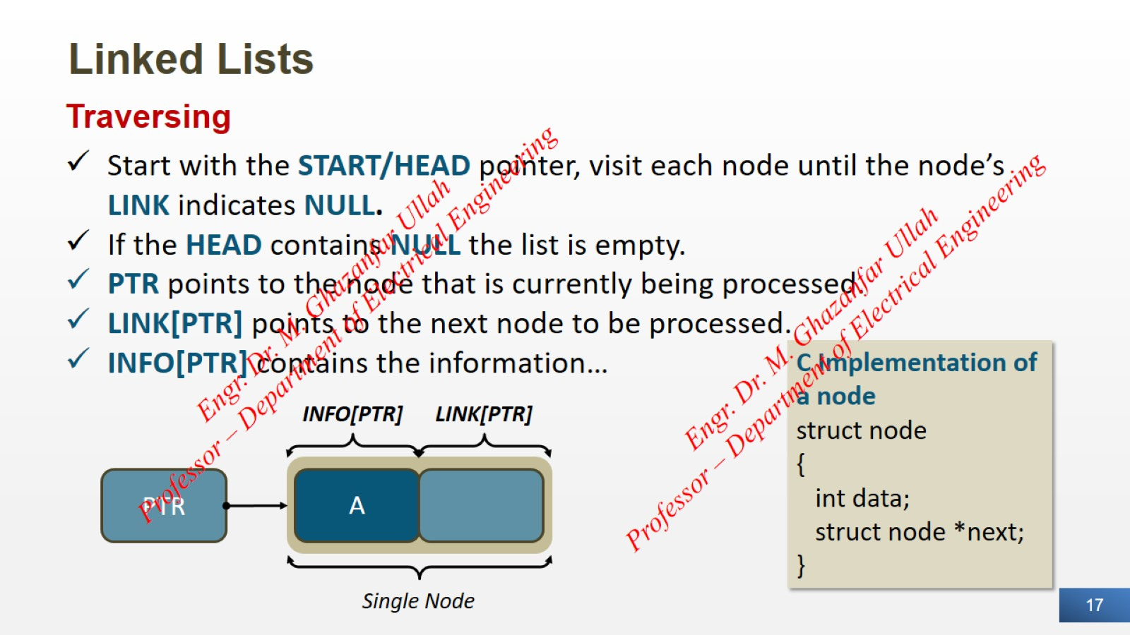
Linked Lists

Slide 18
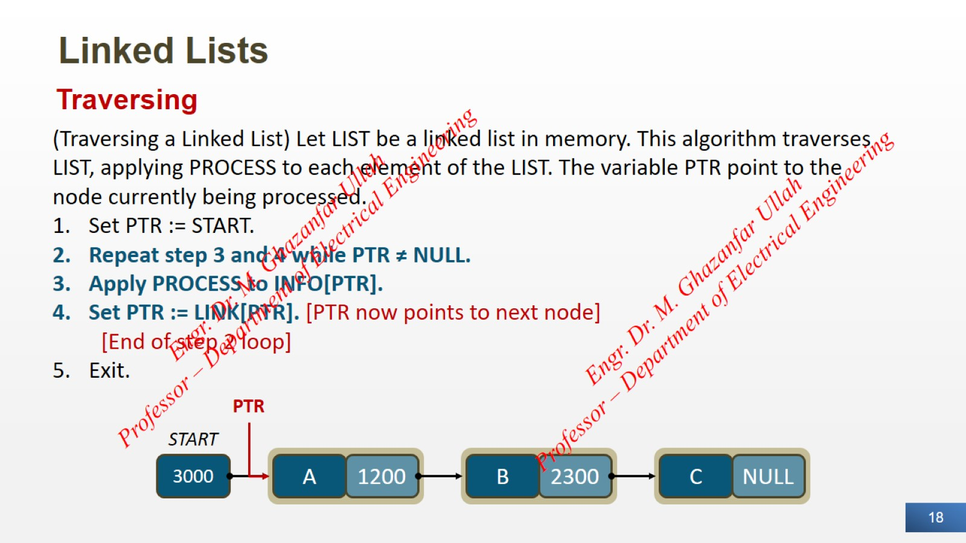
Linked Lists

Slide 19

Linked Lists

Slide 20

Linked Lists

Slide 21
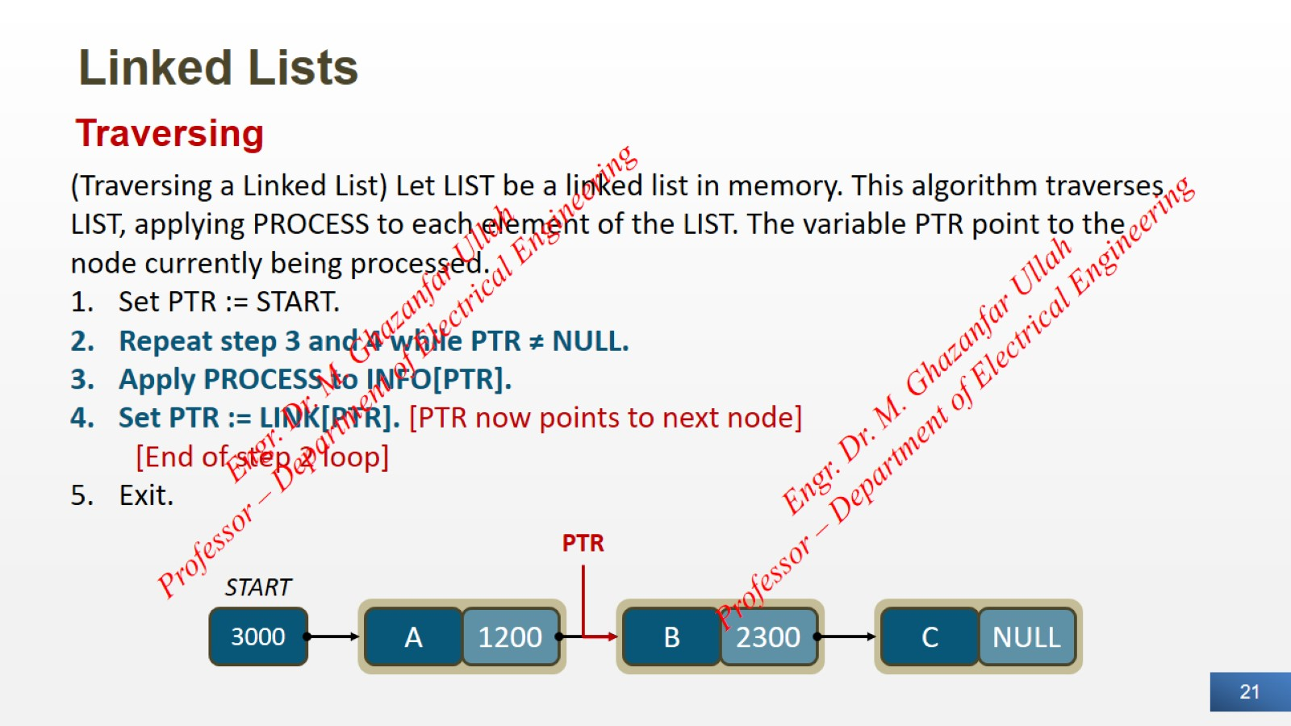
Linked Lists

Slide 22

Linked Lists

Slide 23

Linked Lists

Slide 24
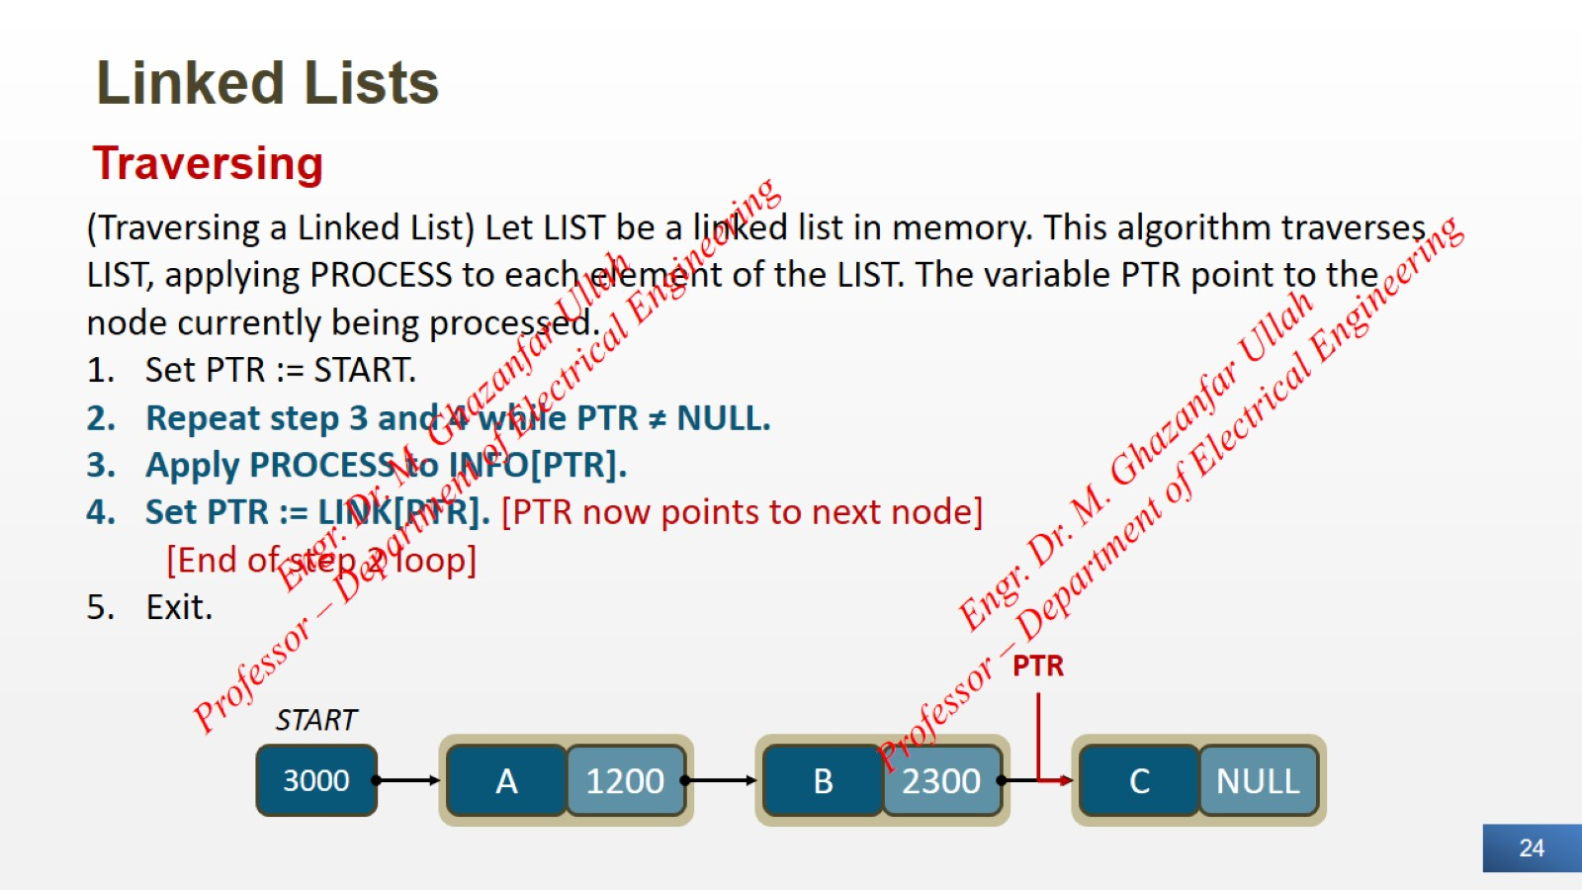
Linked Lists

Slide 25

Linked Lists

Slide 26

Linked Lists

Slide 27

Linked Lists

Slide 28

Linked Lists

Slide 29

Linked Lists

Slide 30
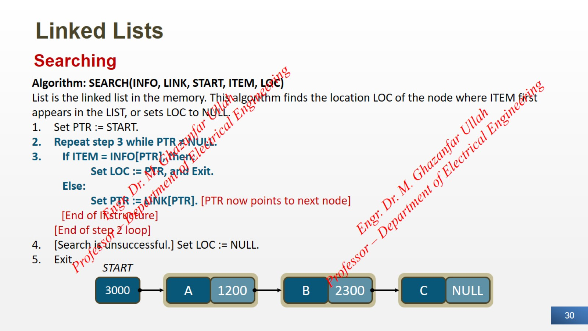
Linked Lists

Slide 31
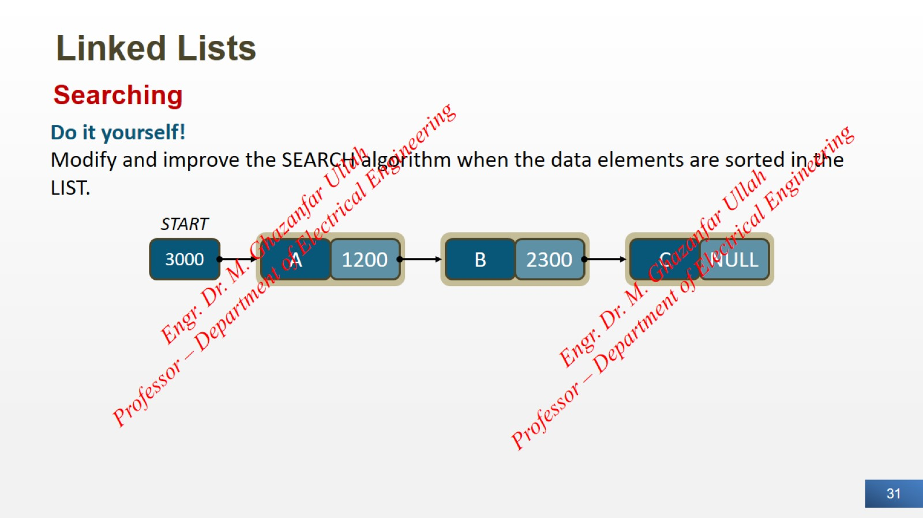
Linked Lists

Slide 32
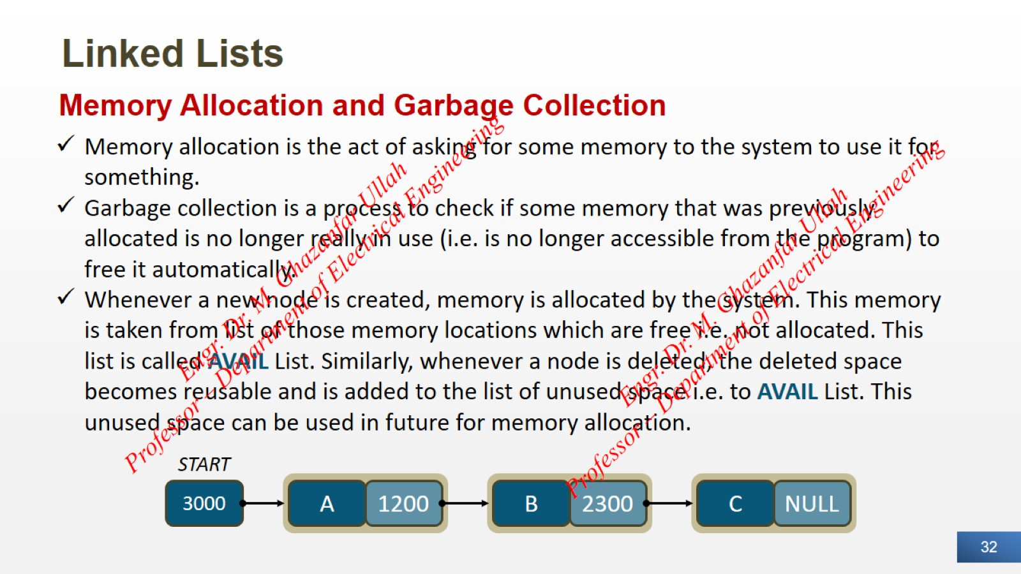
Linked Lists

Slide 33
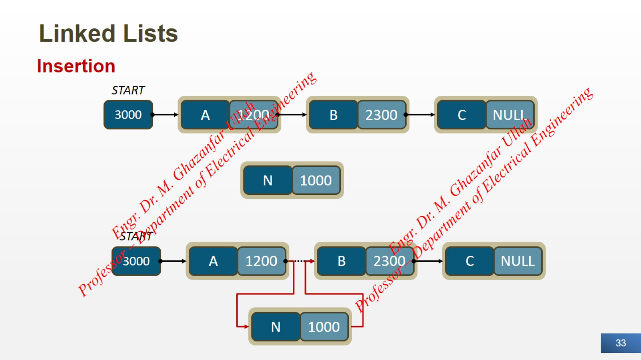
Linked Lists

Slide 34
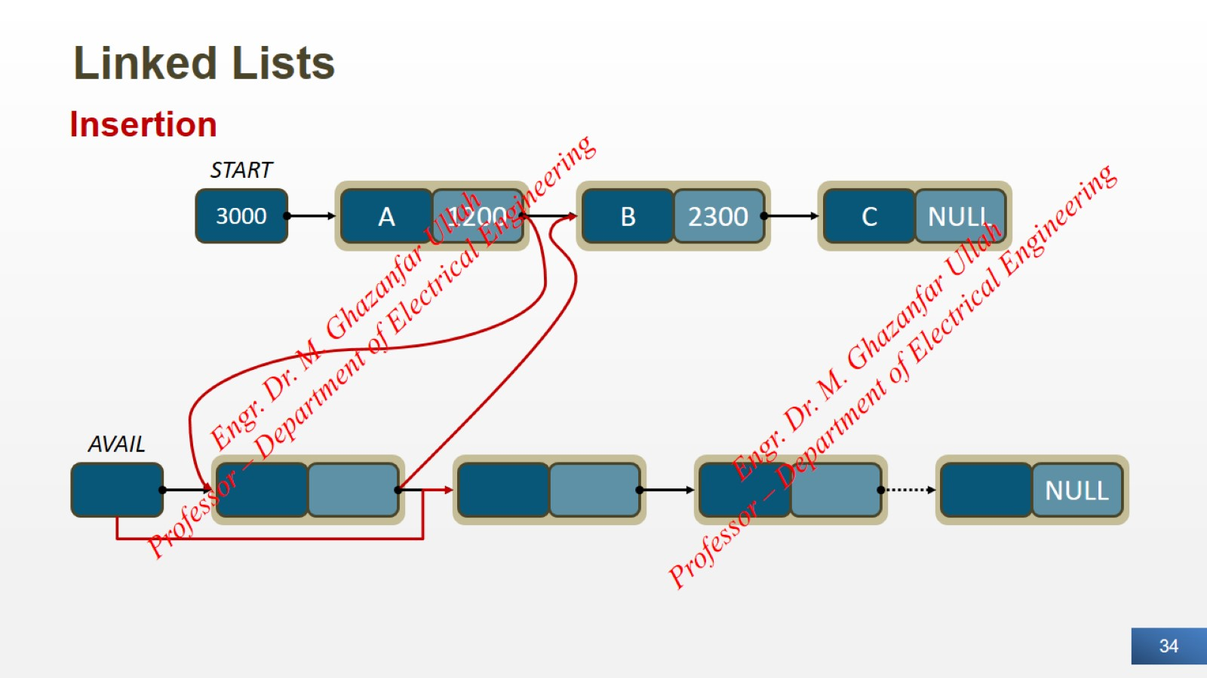
Linked Lists

Slide 35
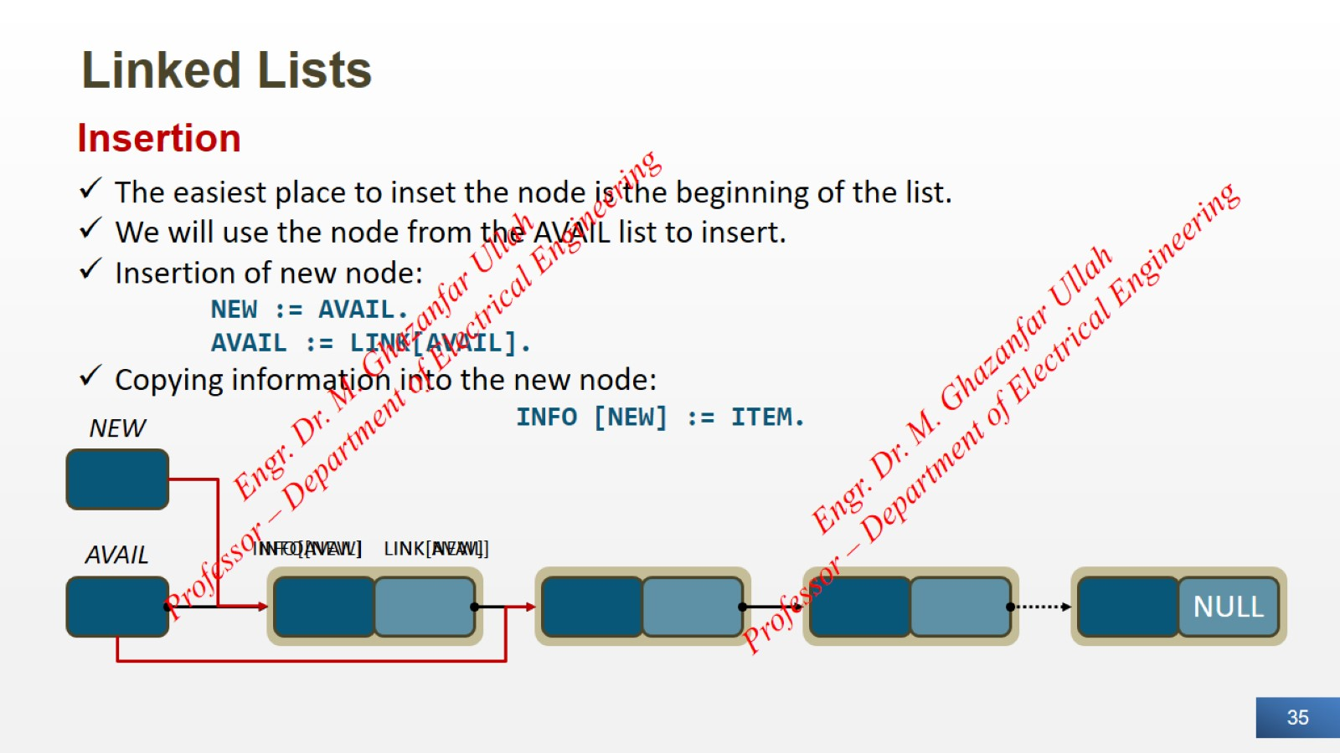
Linked Lists

Slide 36
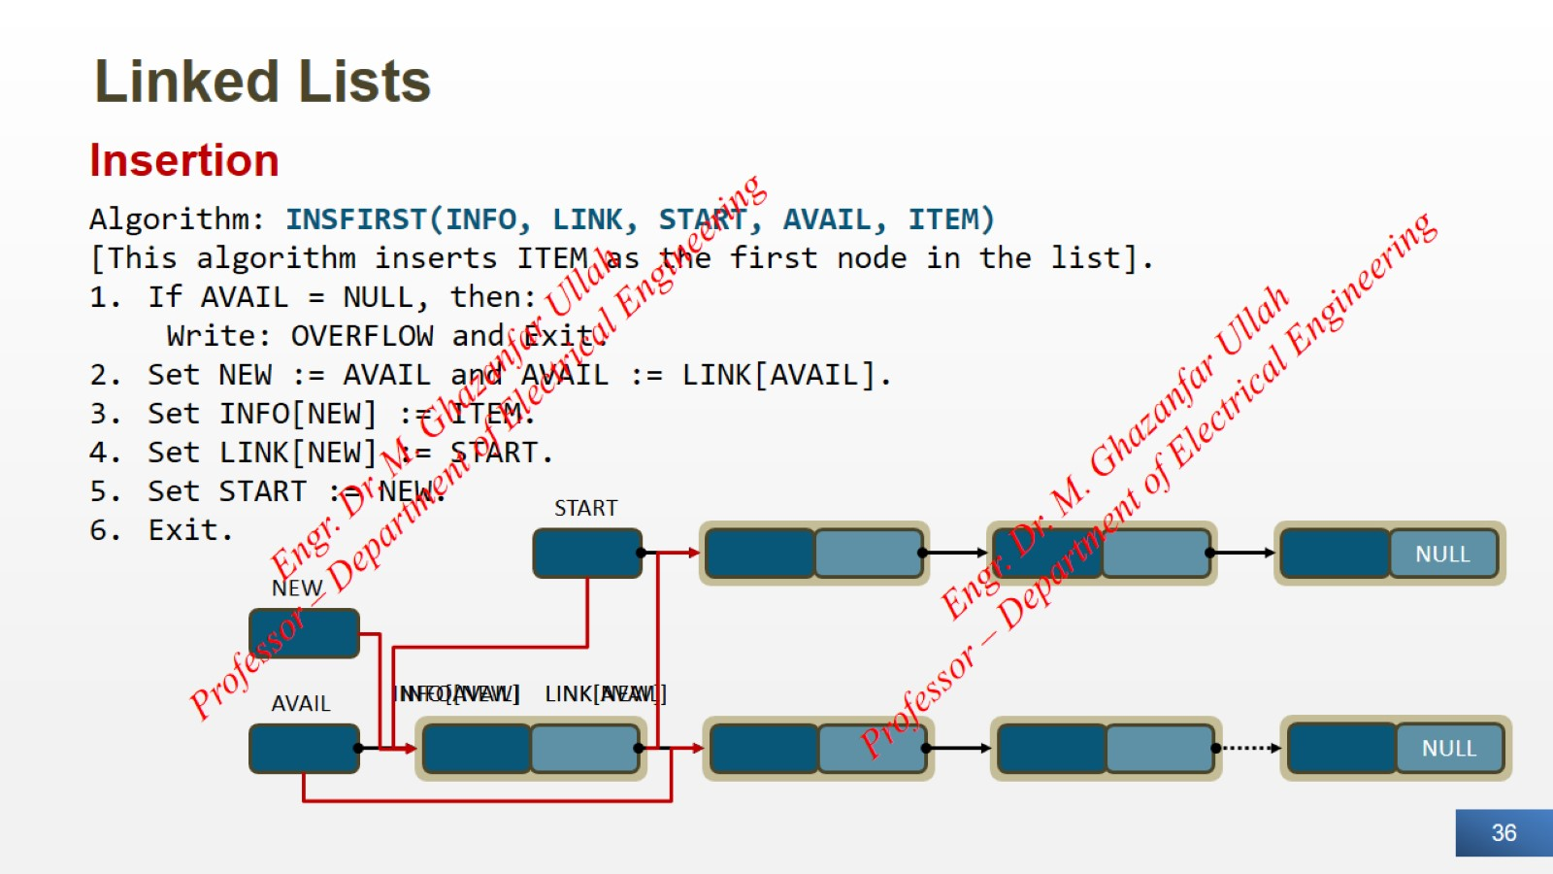
Linked Lists

Slide 37
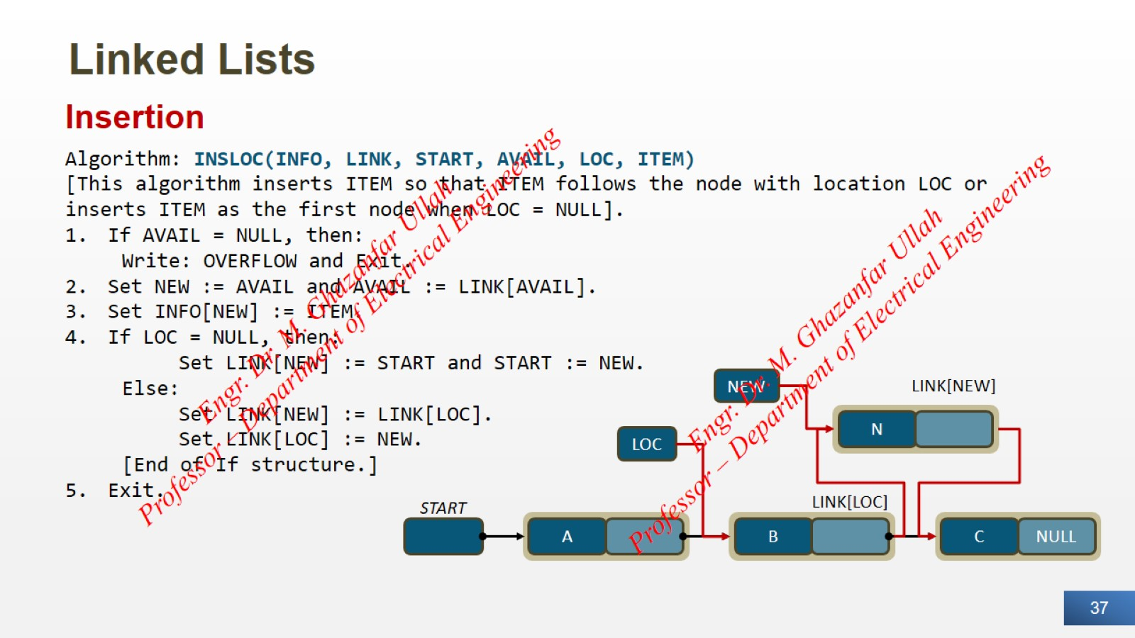
Linked Lists

Slide 38
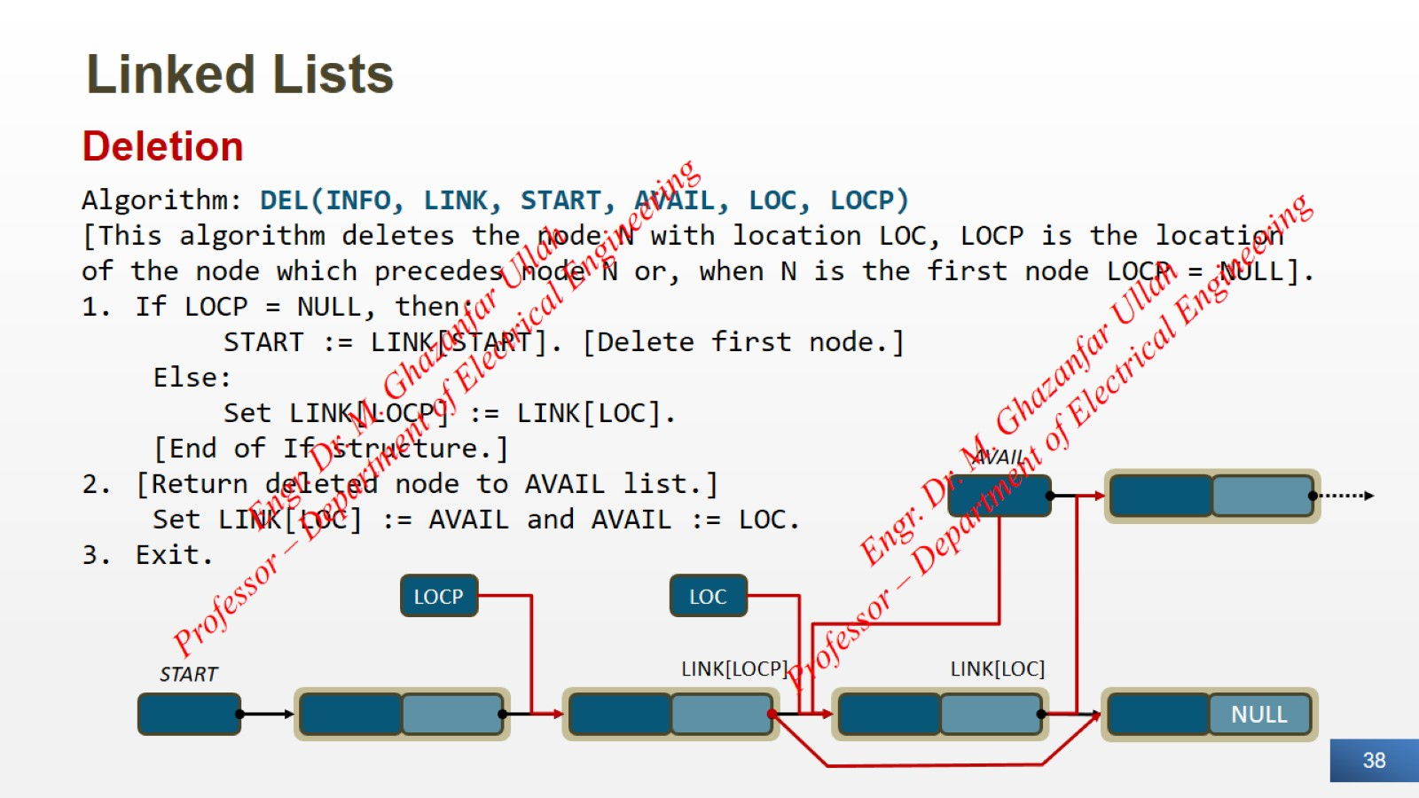
Linked Lists

Slide 39
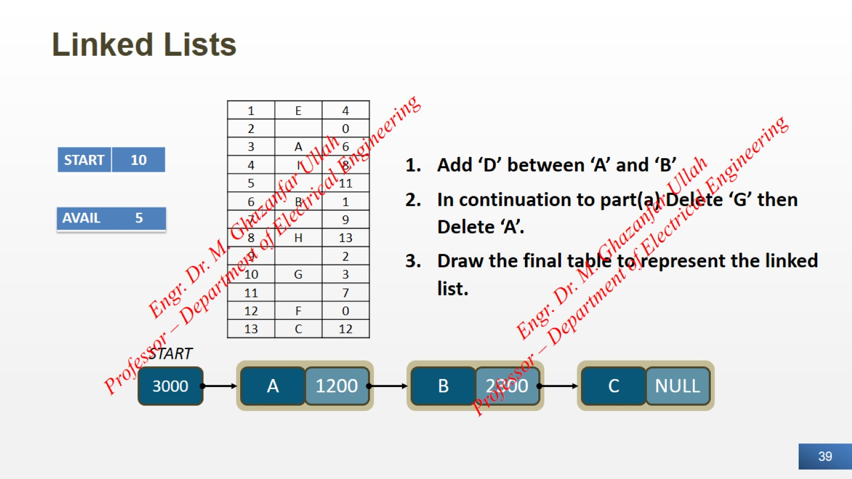
Linked Lists

Slide 40
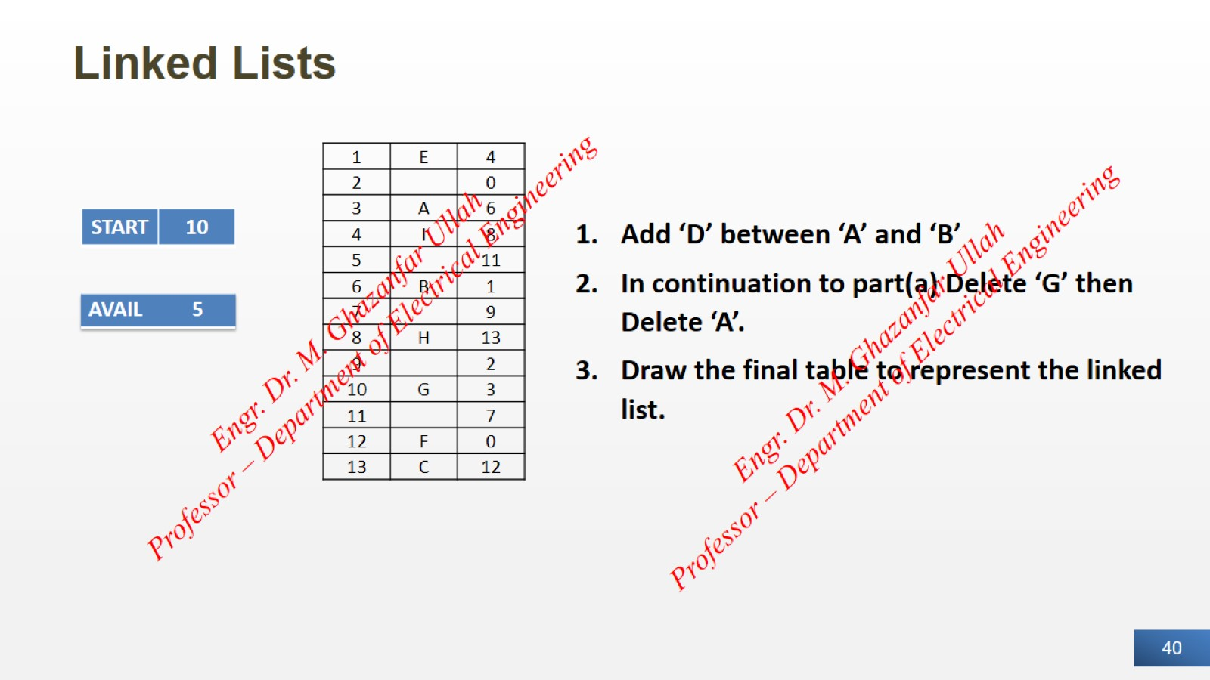
Linked Lists

Slide 41
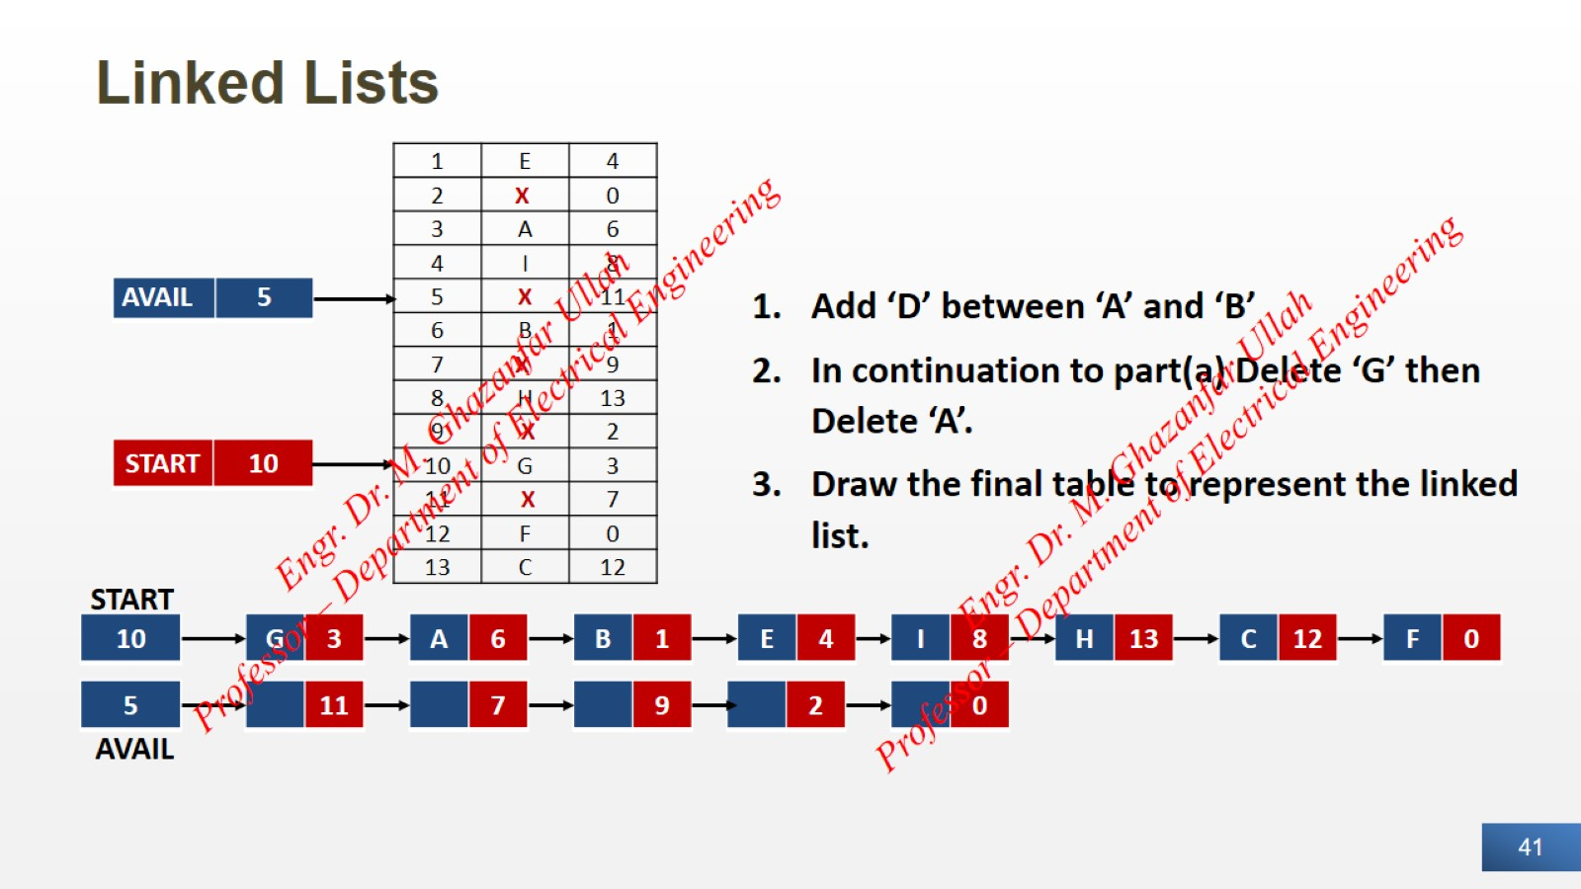
Linked Lists

Slide 42
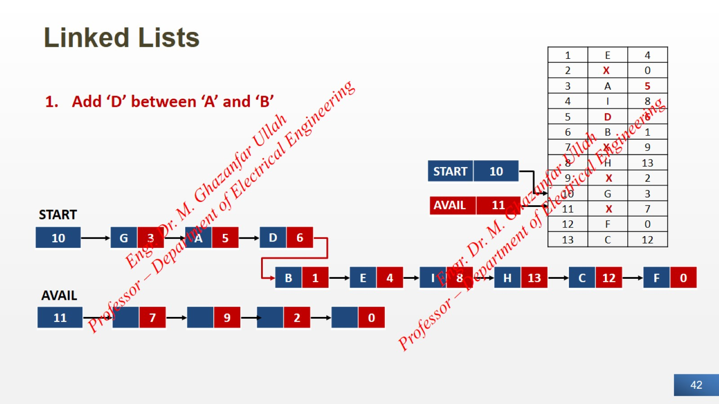
Linked Lists

Slide 43
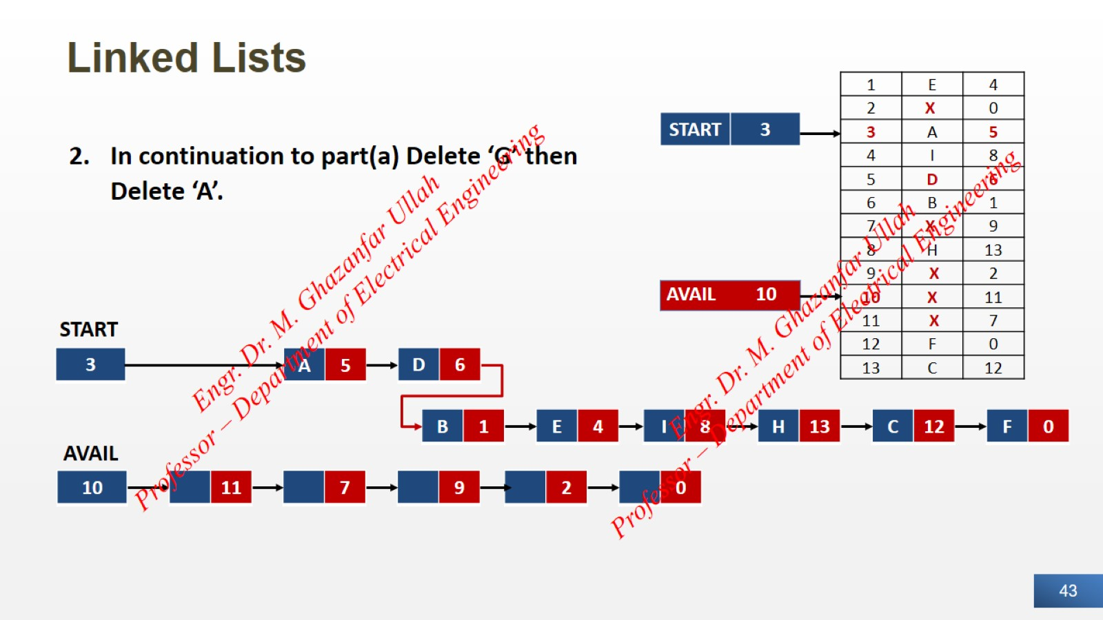
Linked Lists

Slide 44
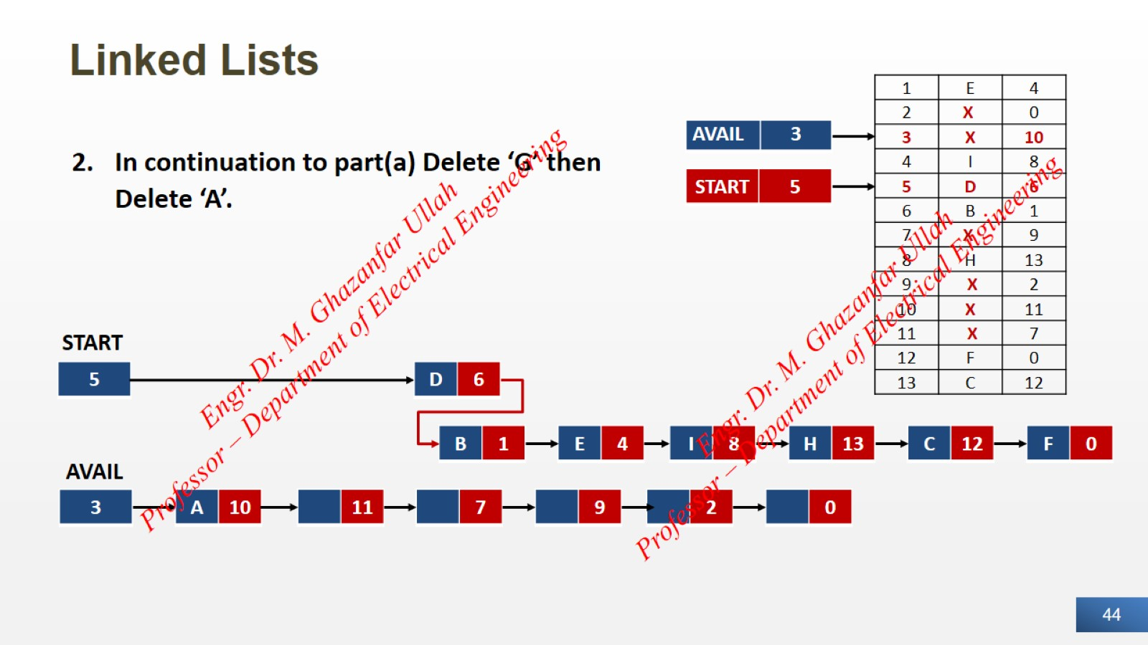
Linked Lists

Slide 45
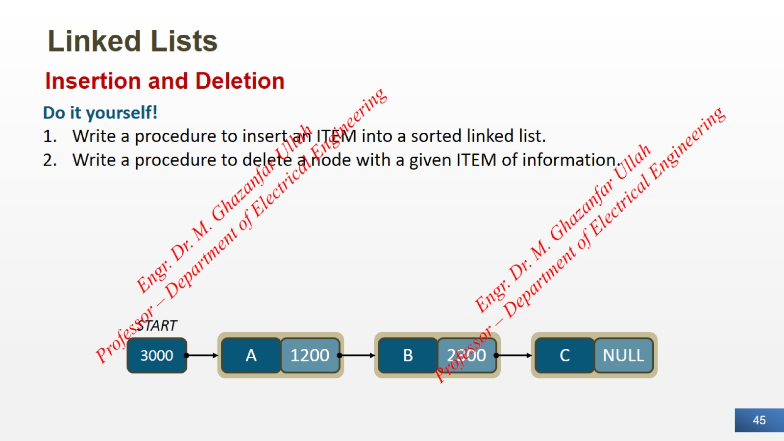
Linked Lists

Slide 46
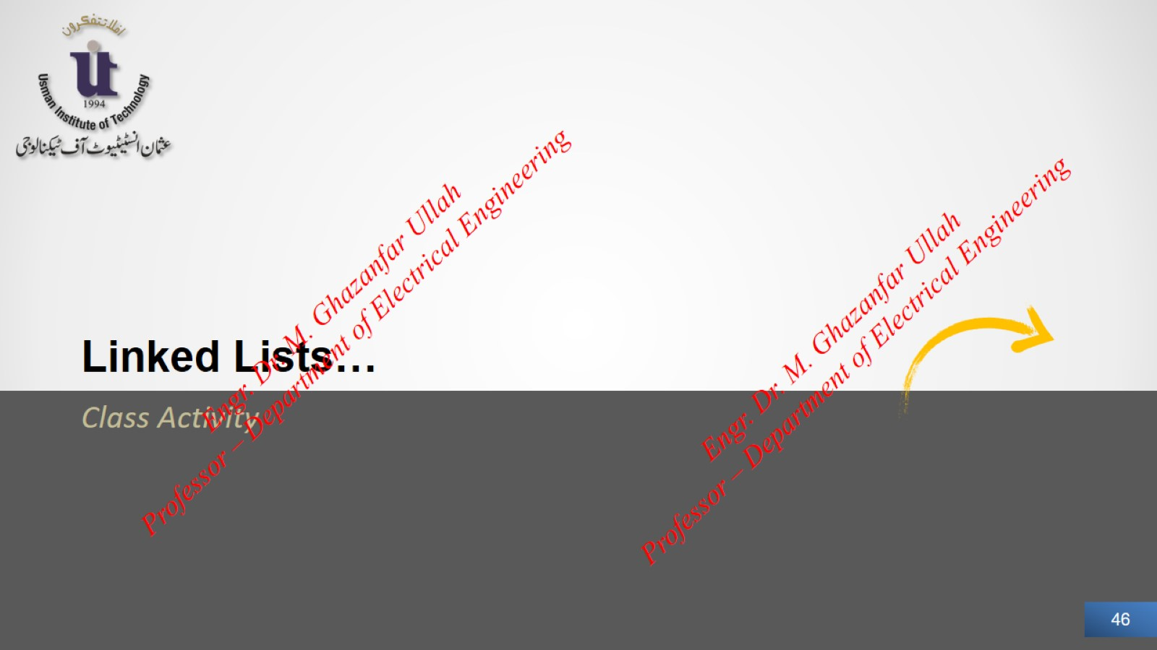

Slide 47
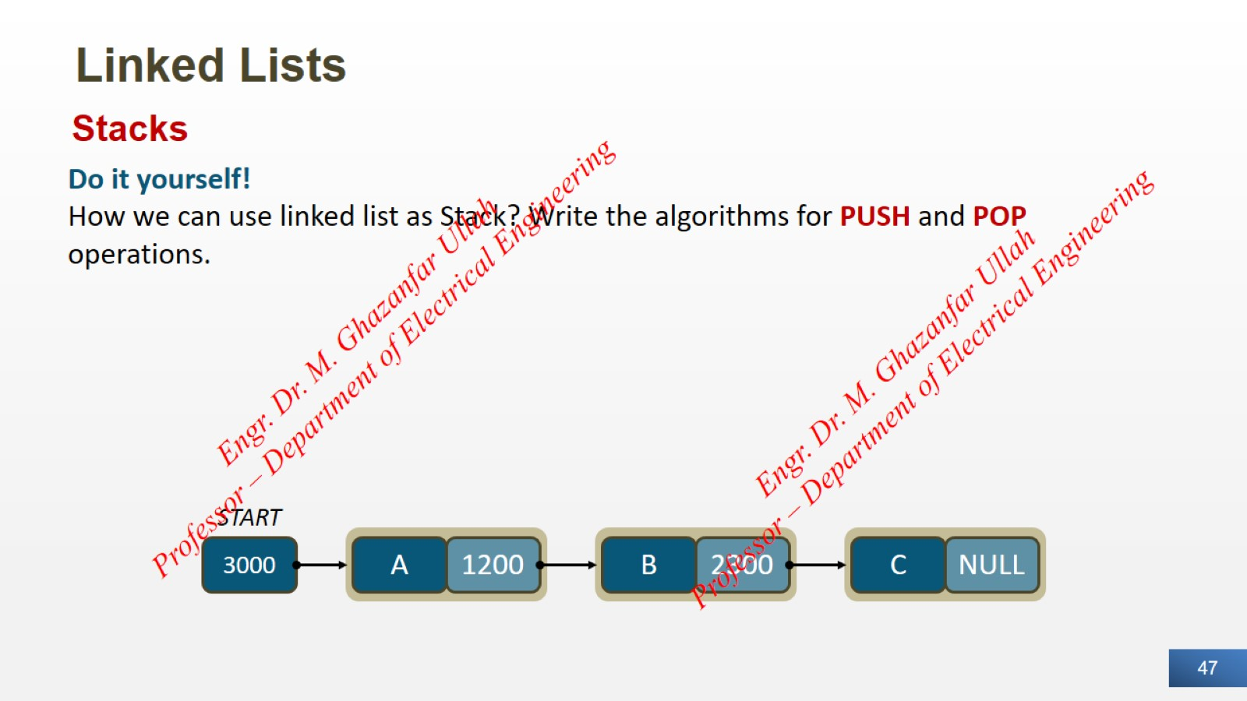
Linked Lists

Slide 48
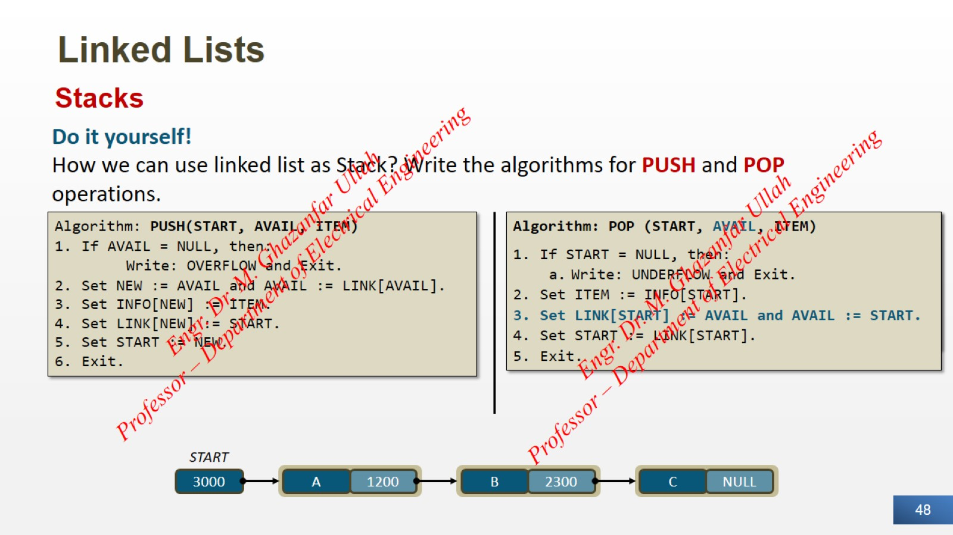
Linked Lists

Slide 49
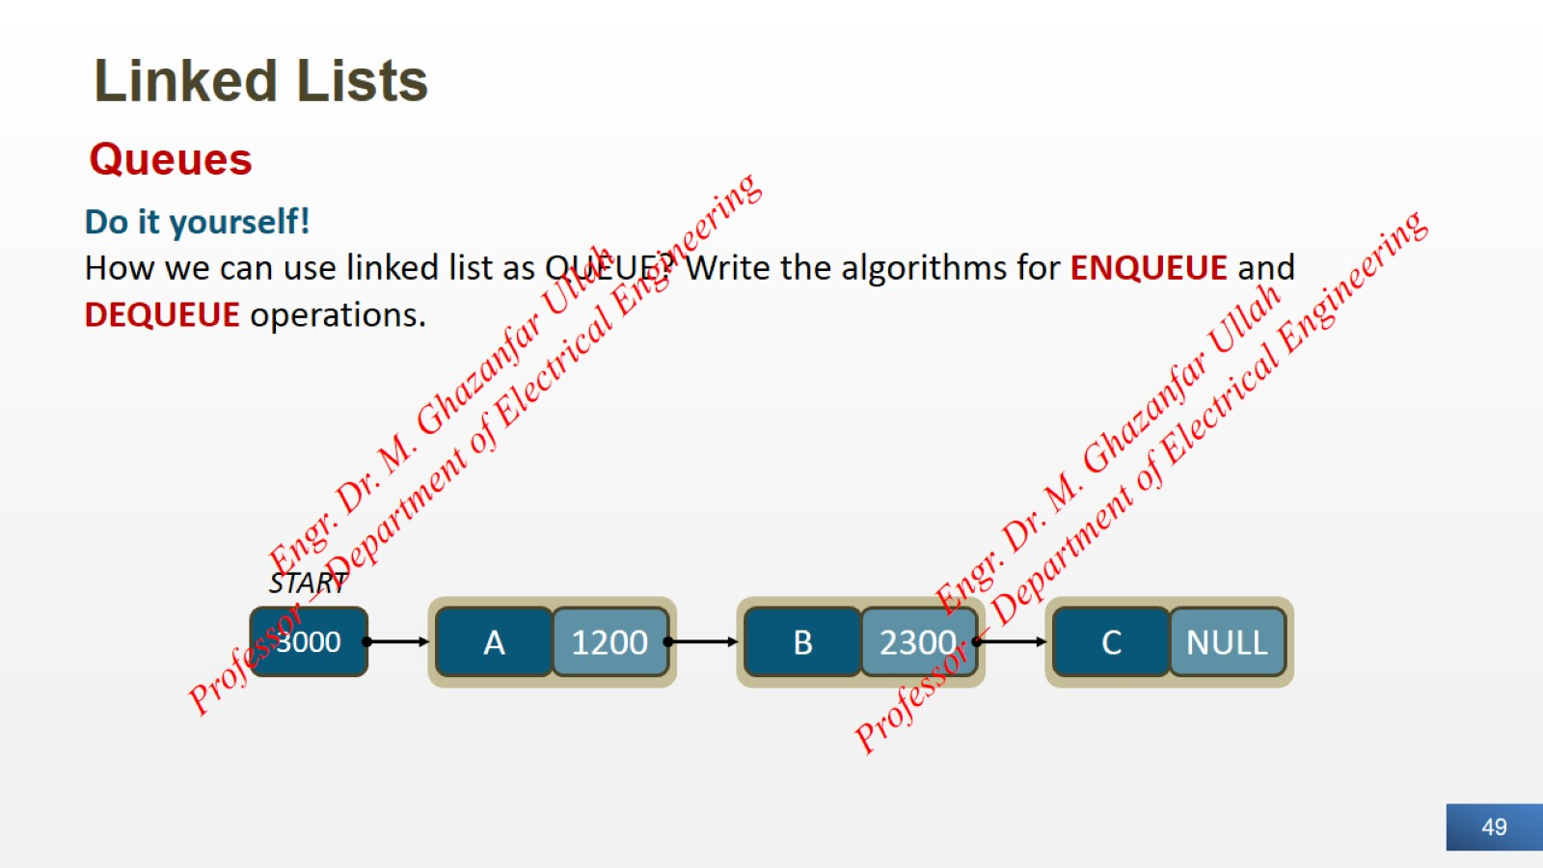
Linked Lists

Slide 50
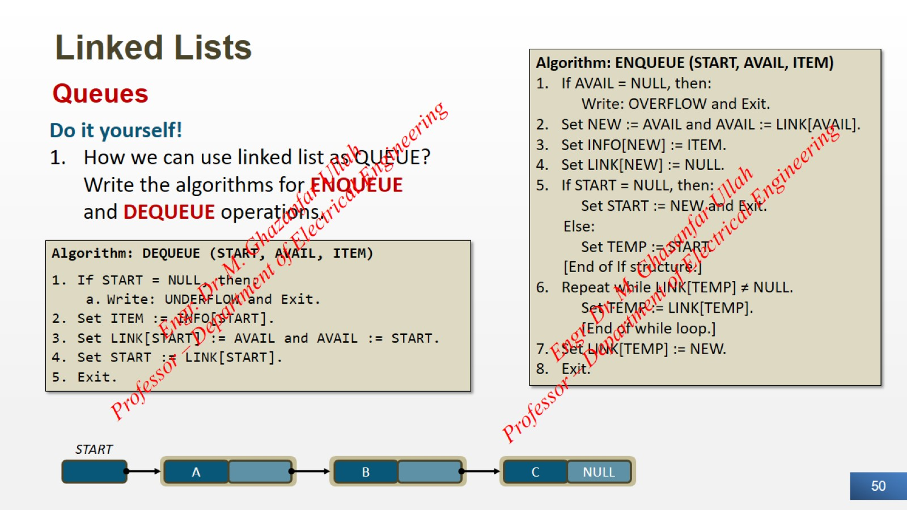
Linked Lists

Slide 51
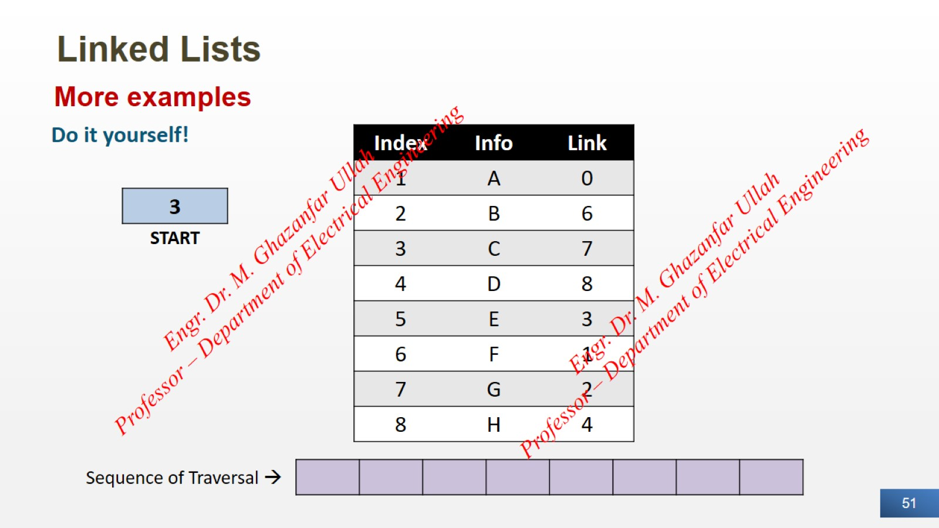
Linked Lists

Slide 52
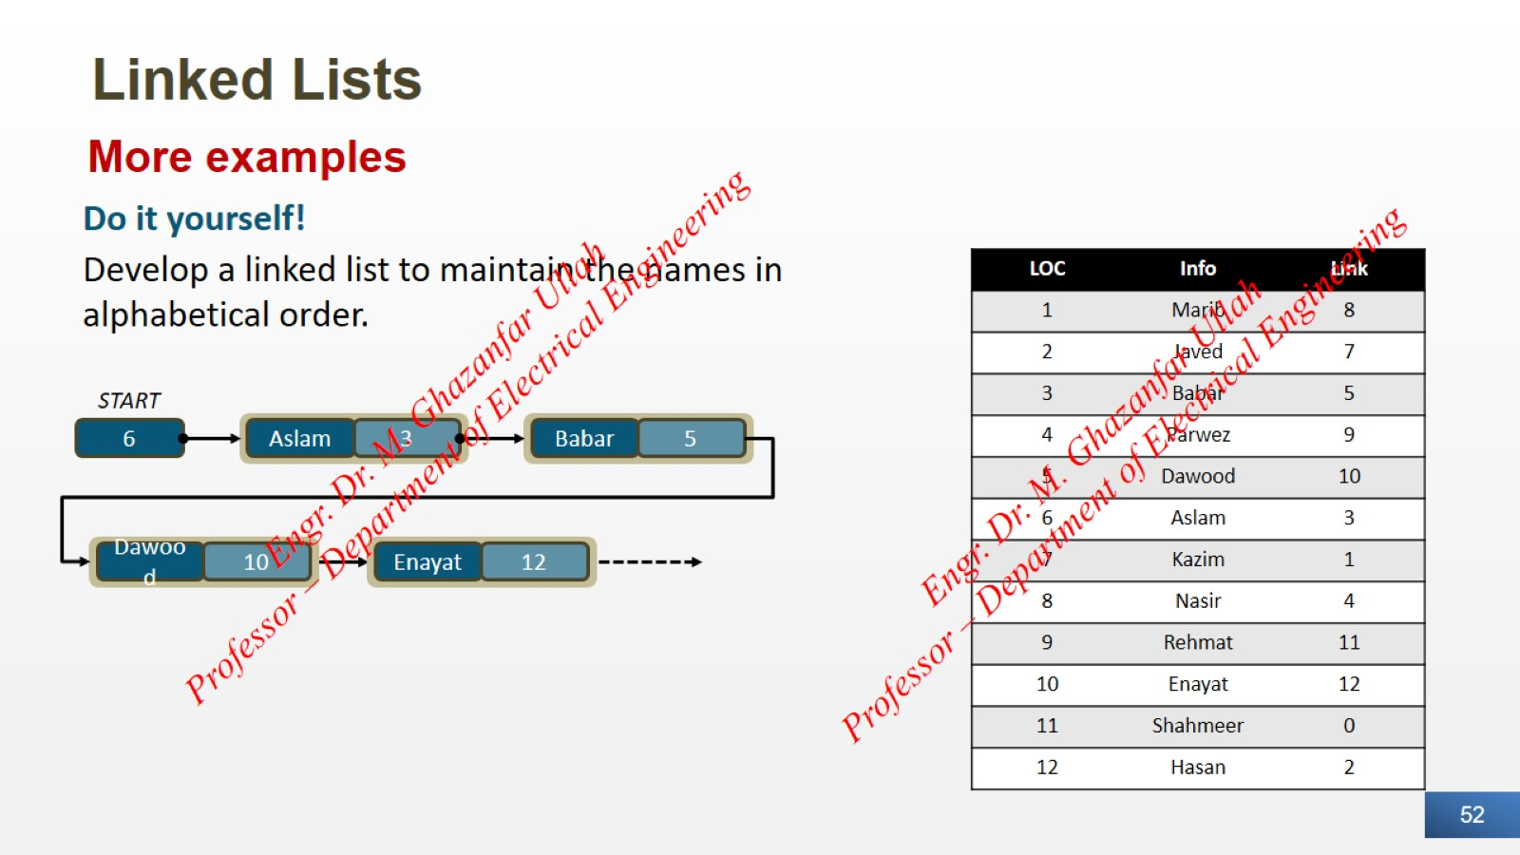
Linked Lists

Slide 53


